Slide 1

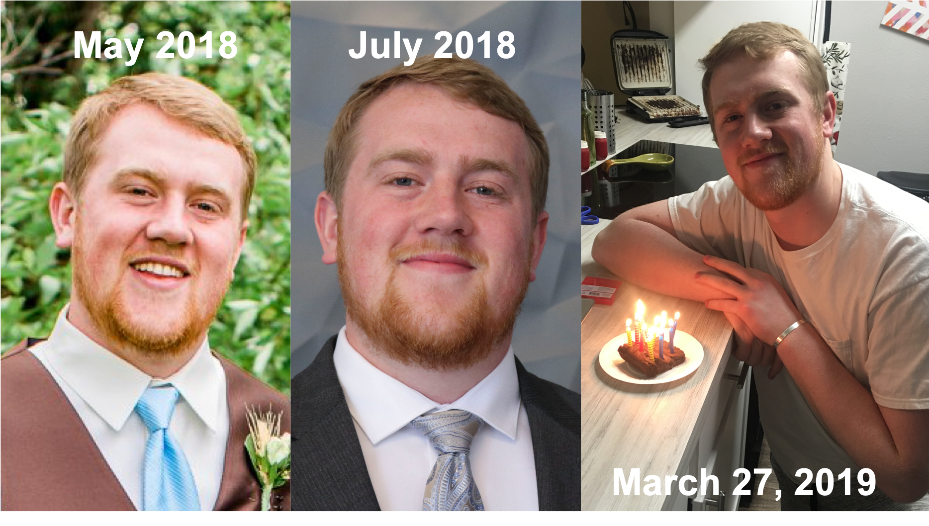






Sign In
Sam hulme
First time here? Say hi by entering a message below. I’m always curious to know who visits my site! After that, feel free to poke around and see what interesting things you can find. There is always new stuff being added!
Enter name or message here…
Say Hello
Resume
Projects
Social
Sam Hulme | (406) 750-8136 | shulme33@gmail.com
Samhulme.com

Slide 2
Sign In
Sam hulme
First time here? Say hi by entering a message below. I’m always curious to know who visits my site! After that, feel free to poke around and see what interesting things you can find. There is always new stuff being added!
Enter name or message here…
Say Hello
Resume
Projects
Social
Sam Hulme | (406) 750-8136 | shulme33@gmail.com
Samhulme.com

Slide 3
Sign In
Sam hulme
First time here? Say hi by entering a message below. I’m always curious to know visits my site! Then feel free to poke around and see what interesting things you can find. There is always new stuff being added!
Enter name or message here…
Say Hello
Resume
Projects
Social Networks
Take a look at my resume
Take a look at my resume
Take a look at my resume
Sam Hulme | (406) 750-8136 | shulme33@gmail.com
Samhulme.com

Slide 4


Sign In
Sam hulme
First time here? Say hi by entering a message below. I’m always curious to know who visits my site! After that, feel free to poke around and see what interesting things you can find. There is always new stuff being added!
Enter name or message here…
Say Hello
Sam Hulme | (406) 750-8136 | shulme33@gmail.com
Samhulme.com

Slide 5
EA212D
D41E29
353535
F6F6F6

Slide 6




Home
Projects
Resume
Sam hulme
Resume
Projects
About
Resume
This is some random text that will eventually be something I care about
Summary
Education
Work Experience
Skills

Slide 7
Home
Projects
Resume
Sam hulme
Resume
Projects
About
Projects
This is some random text that will eventually be something I care about

Slide 8



Home
Projects
Resume
Sam hulme
Resume
Projects
About
Resume
This is some random text that will eventually be something I care about
My Skills
Implementation Consultant
Research Assistant
Course Assistant
Education
Montana State University Bozeman
August 2013 – May 2018
B.S. in Computer Science
With Minor in Electrical Engineering
Overall GPA: 3.59

Slide 9
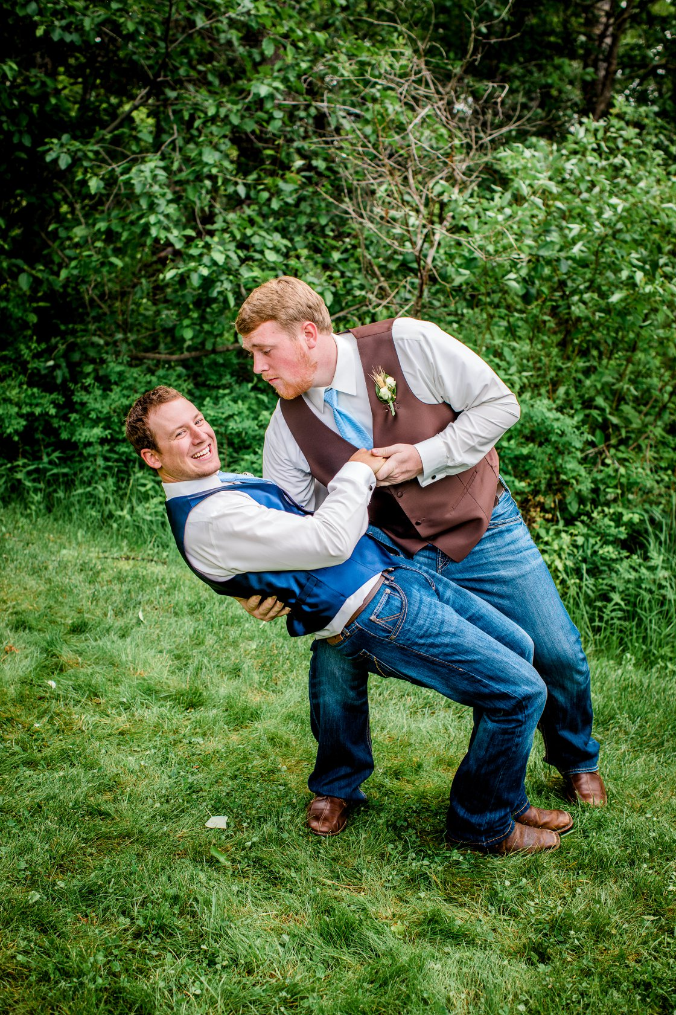
Home
Projects
Resume
Sam hulme
Resume
Projects
About
About
This is some random text that will eventually be something I care about
Early Life
College
Hobbies

Slide 10
Home
Projects
Resume
Sam hulme
Resume
Projects
About
About
This is some random text that will eventually be something I care about
Notes:
Favorite Movie
Favorite Superhero

Slide 11
Home
About
Resume
Projects
Sign In
Sam hulme
First time here? Say hi by entering a message below. I’m always curious to know who visits my site! After that, feel free to poke around and see what interesting things you can find. There is always new stuff being added!
Enter name or message here…
Say Hello
Sam Hulme | (406) 750-8136 | shulme33@gmail.com
Samhulme.com

Slide 12
Gradient on the top navbar. Light on the bottom and dark on the top.
Sections
About
Where I Grew Up
My favorite superheros
My favorite movie
Projects
Resume
Button for Resume Download
Skills
Work Experience
Education
Add a questionnaire with fun questions that the person might answer. Favorite superhero, favorite movie, etc…

Slide 13
Color Scheme
#1F222A
#8F9294
#A5BCC3
#D9E0E2
#F4F3F3

